Slide 1
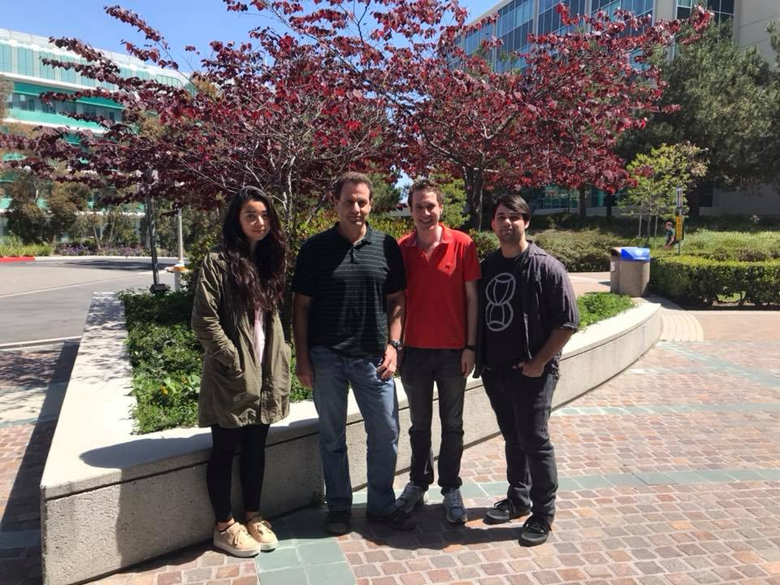
Sampling general distributions with quasi-regular grids: Applications to the calculations of vibrational spectra
Vladimir Mandelshtam, University of California, Irvine
Shane Flynn
1 B.C.

Slide 2
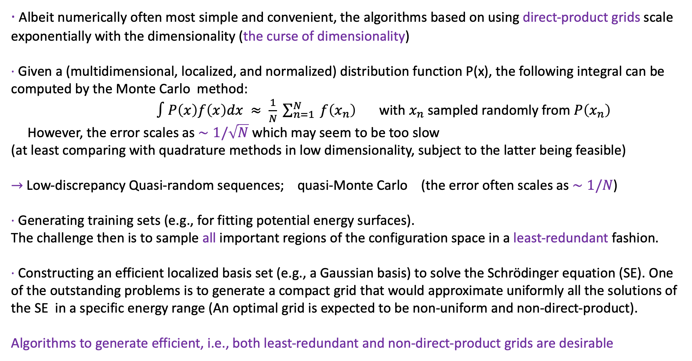
Motivation
∙ Albeit numerically often most simple and convenient, the algorithms based on using direct-product grids scale exponentially with the dimensionality (the curse of dimensionality)
∙ Given a (multidimensional, localized, and normalized) distribution function P(x), the following integral can be computed by the Monte Carlo method:
$∫P\left(x\right)f\left(x\right)dx ≈ \frac{1}{N} \sum_{n=1}^{N}{ f\left(x_{n}\right)}$ with $x_{n}$ sampled randomly from $P\left(x_{n}\right)$
However, the error scales as $∼1/\sqrt{N}$ which may seem to be too slow
(at least comparing with quadrature methods in low dimensionality, subject to the latter being feasible)
$→$Low-discrepancy Quasi-random sequences; quasi-Monte Carlo (the error often scales as $∼1/N$)
∙ Generating training sets (e.g., for fitting potential energy surfaces).
The challenge then is to sample all important regions of the configuration space in a least-redundant fashion.
∙ Constructing an efficient localized basis set (e.g., a Gaussian basis) to solve the Schrödinger equation (SE). One of the outstanding problems is to generate a compact grid that would approximate uniformly all the solutions of the SE in a specific energy range (An optimal grid is expected to be non-uniform and non-direct-product).
Algorithms to generate efficient, i.e., both least-redundant and non-direct-product grids are desirable

Slide 3
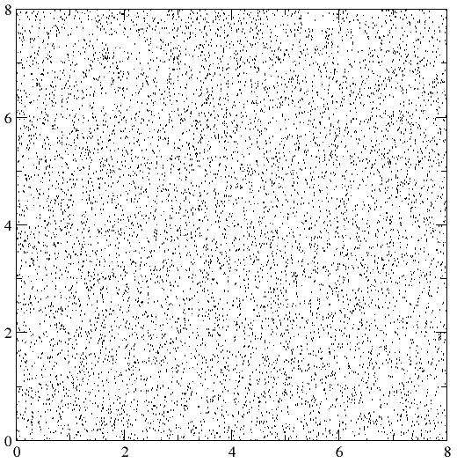
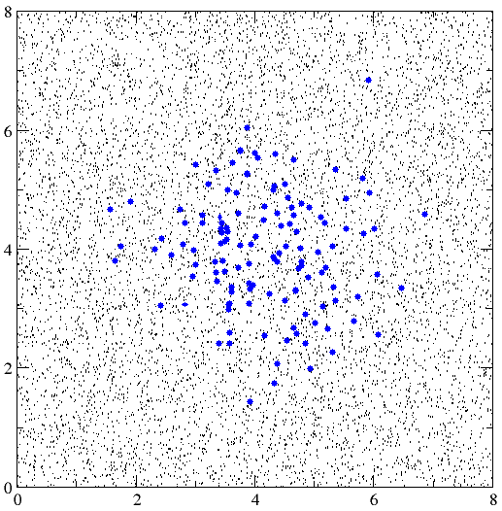
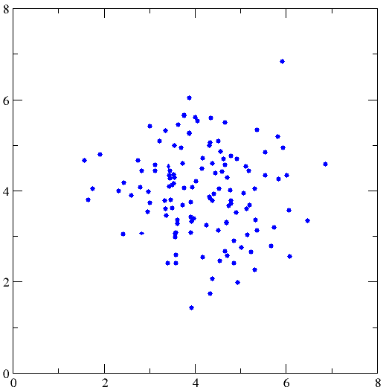
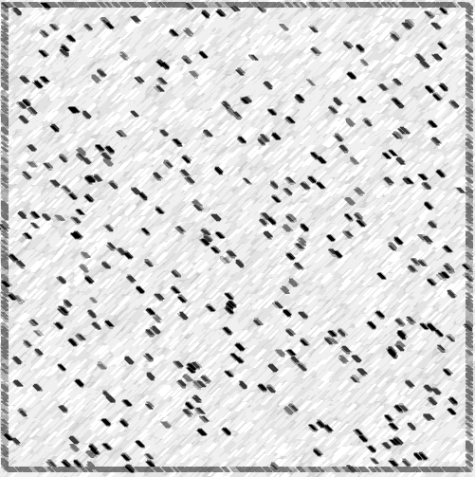
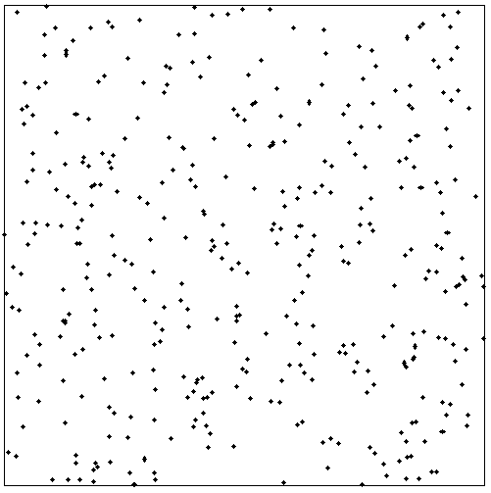
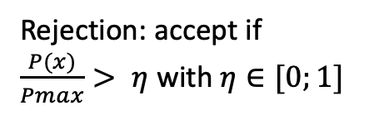
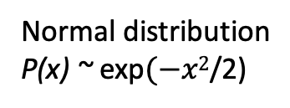
Example: Sampling a general distribution P(x) using a pseudo-random sequence
Rejection: accept if
$\frac{P(x)}{Pmax}> η$ with $η∈[0;1]$
Normal distribution
P(x) ~ exp$(−x2$/2)
Pseudo-random uniform

Slide 4
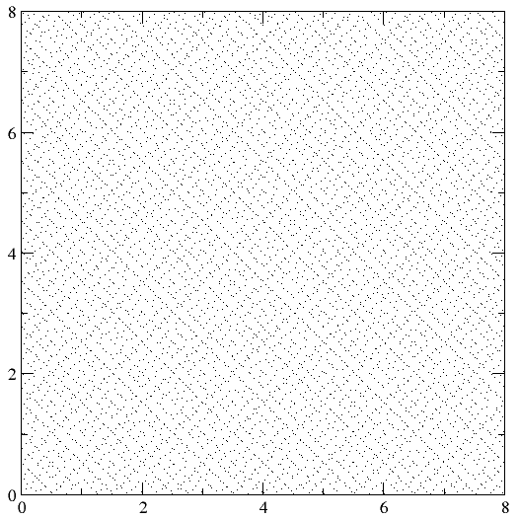
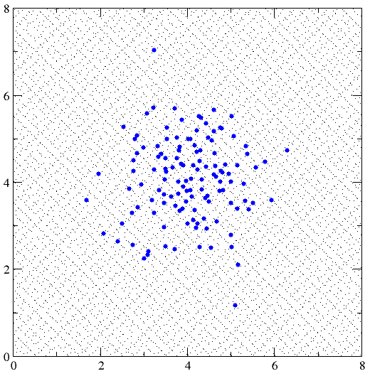
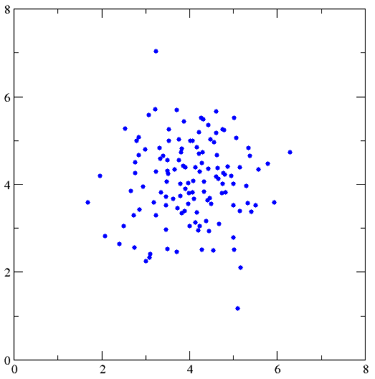
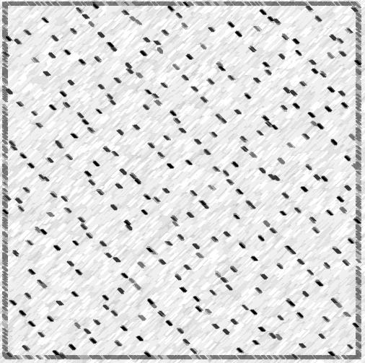
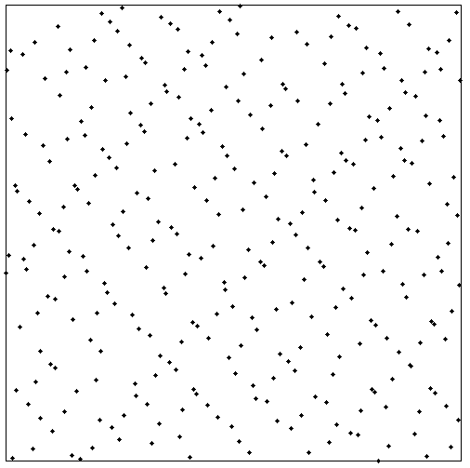
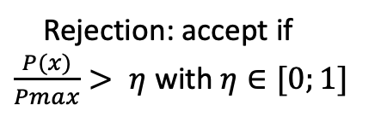
Sampling normal distribution using pseudo-random sequence and rejection method
Rejection: accept if
$\frac{P(x)}{Pmax}> η$ with $η∈[0;1]$
Uniform Quasi-random
(Sobol sequence)
Normal distribution
Uniform quasi-random + rejection: the local uniformity is destroyed (broken teeth)
Uniform pseudo-random + rejection

Slide 5
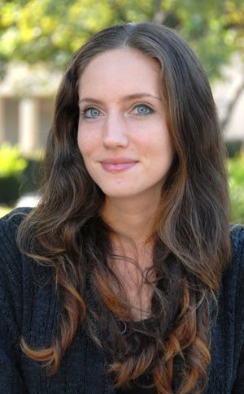
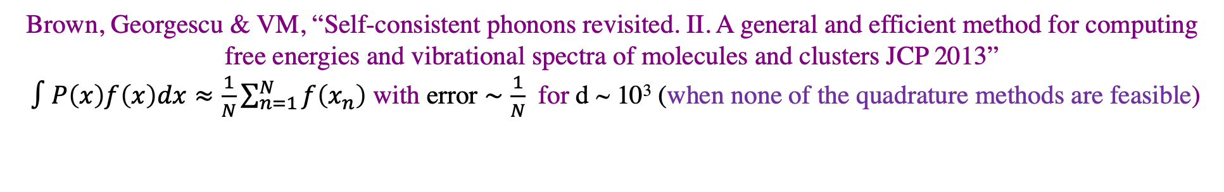
A much better method using a uniform low-discrepancy sequence to sample a product distribution, P(x₁, …, x_{d}) = P₁ (x₁) ✕ … ✕ P₁ (x_{d}).
Uniform quasi-random (Sobol) sequence
Normal distribution
N=128
Using inverse Cumulative Distribution Function: all points will be preserved together with their local uniformity property
N=256
Sandra Brown
Brown, Georgescu & VM, “Self-consistent phonons revisited. II. A general and efficient method for computing free energies and vibrational spectra of molecules and clusters JCP 2013”
$∫P\left(x\right)f\left(x\right)dx≈\frac{1}{N}\sum_{n=1}^{N}{f\left(x_{n}\right)}$ with error $∼\frac{1}{N}$ for d ~ 10³ (when none of the quadrature methods are feasible)

Slide 6
Can we do better?
The bad news is that a low-discrepancy sequence, as defined for the uniform distribution, is straightforward to transform to a multidimensional distribution P(x) only for special cases (e.g., when P(x) is a product of 1D distributions, P(x₁, …, x_{d}) = P₁ (x₁) ✕ … ✕ P₁ (x_{d}), and the rejection method in conjunction with a low-discrepancy sequence is not appealing.
Non-uniform quasi - regular grid?

Slide 7
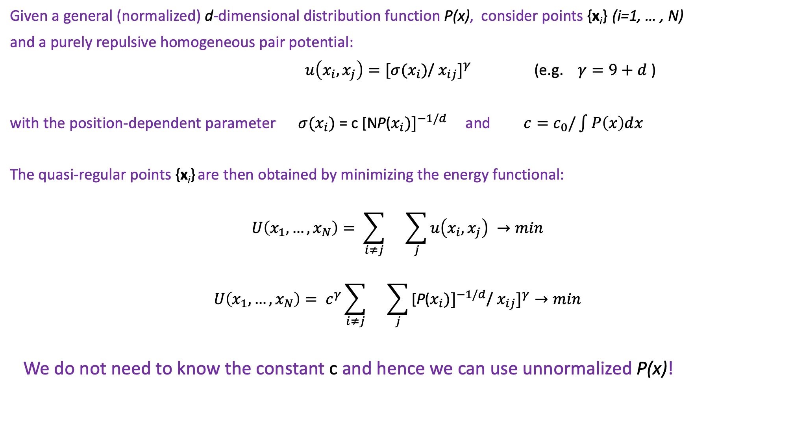
Quasi-regular grid Shane Flynn and VM (JCP 2019, JCTC 2021).
Given a general (normalized) d-dimensional distribution function P(x), consider points {x_{i}} (i=1, … , N)
and a purely repulsive homogeneous pair potential:
$u\left(x_{i}, x_{j}\right)=[σ(x_{i})$/ ${x_{ij}]}^{γ}$ (e.g. $γ=9+d$ )
with the position-dependent parameter $σ(x_{i})$ = c [NP(${x_{i})]}^{−1/d}$ and $c=c_{0}/\int{P\left(x\right)dx}$
The quasi-regular points {x_{i}} are then obtained by minimizing the energy functional:
$$U\left(x_{1},…,x_{N}\right)= \sum_{i≠j}{}\sum_{j}{u\left(x_{i}, x_{j}\right) →min}$$
$$U\left(x_{1},…,x_{N}\right)= c^{γ}\sum_{i≠j}{}\sum_{j}{\text{[}\text{P}\text{(}{x_{i})]}^{−1/d}\text{/} {x_{ij}]}^{γ}→min}$$
We do not need to know the constant c and hence we can use unnormalized P(x)!

Slide 8
Normal distribution (N=128)

Slide 9
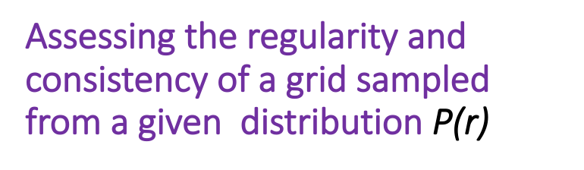
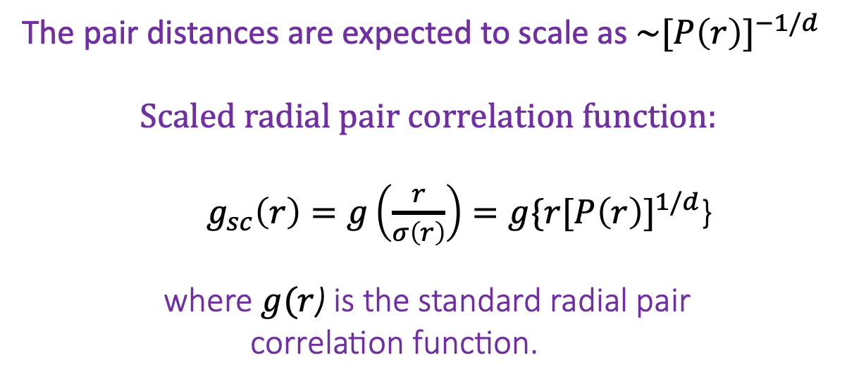
Assessing the regularity and consistency of a grid sampled from a given distribution $\text{P}\text{(}\text{r}\text{)}$
The pair distances are expected to scale as ${\sim [P\left(r\right)]}^{−1/d}$
$$Scaled radial pair correlation function:$$
$g_{sc}\left(r\right)=g\left(\frac{r}{σ\left(r\right)}\right)=g\{r{[P\left(r\right)]}^{1/d}$}
where $g(r$) is the standard radial pair
correlation function.
0.0 1.0

Slide 10
Calculating vibrational molecular spectra using distributed Gaussian basis.
Davis & Heller (J. Comput. Phys. 1979 )
Hamilton & Light. (J. Chem. Phys. 1986)
Bacic & Light. (J. Chem. Phys. 1986, 1987, 1988)
Garashchuk & Light (J. Chem. Phys. 2001)
Poirier & Light. (J. Chem. Phys. 2000)
Manzhos & Carrington (J. Chem. Phys. 2016)

Slide 11
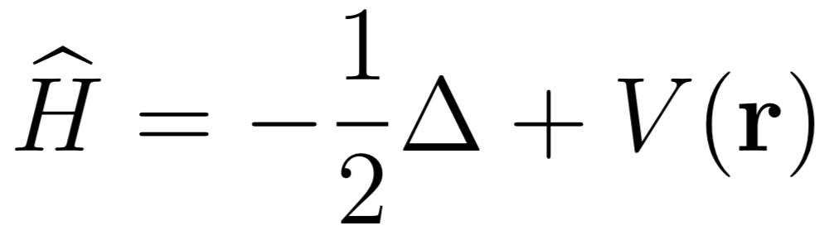
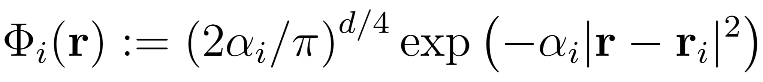
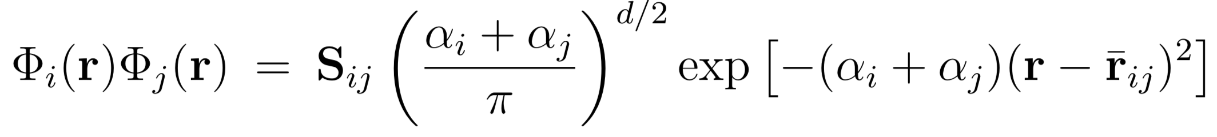
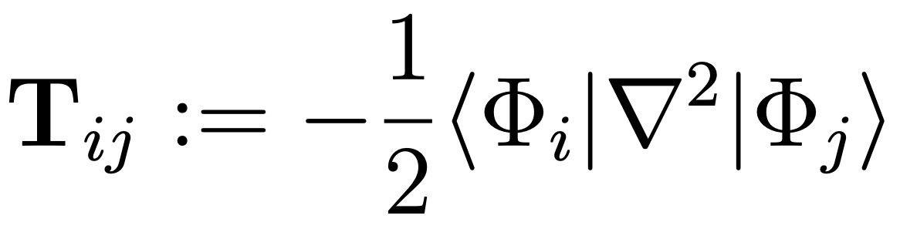
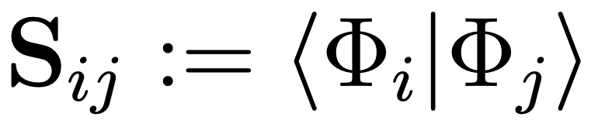
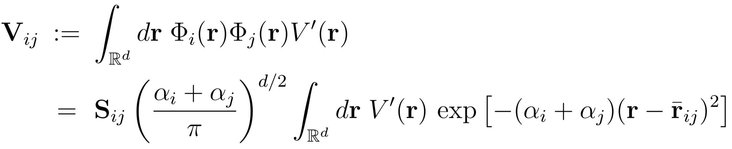
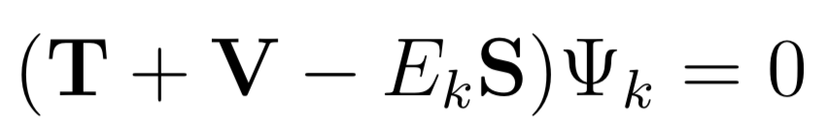
Calculating eigenenergies and eigenfunctions of a d-dimensional Hamiltonian using a distributed Gaussian basis in Cartesian coordinates
Hamiltonian (mass-scaled Cartesian coordinates):
Gaussian basis:
(i=1, …, N)
Product of two Gaussians is aGaussian
The kinetic energy and overlap
matrices are analytic:
Potential energy matrix elements are computed by sparse Gauss-Hermit quadratures:
Generalized eigenvalue problem:

Slide 12
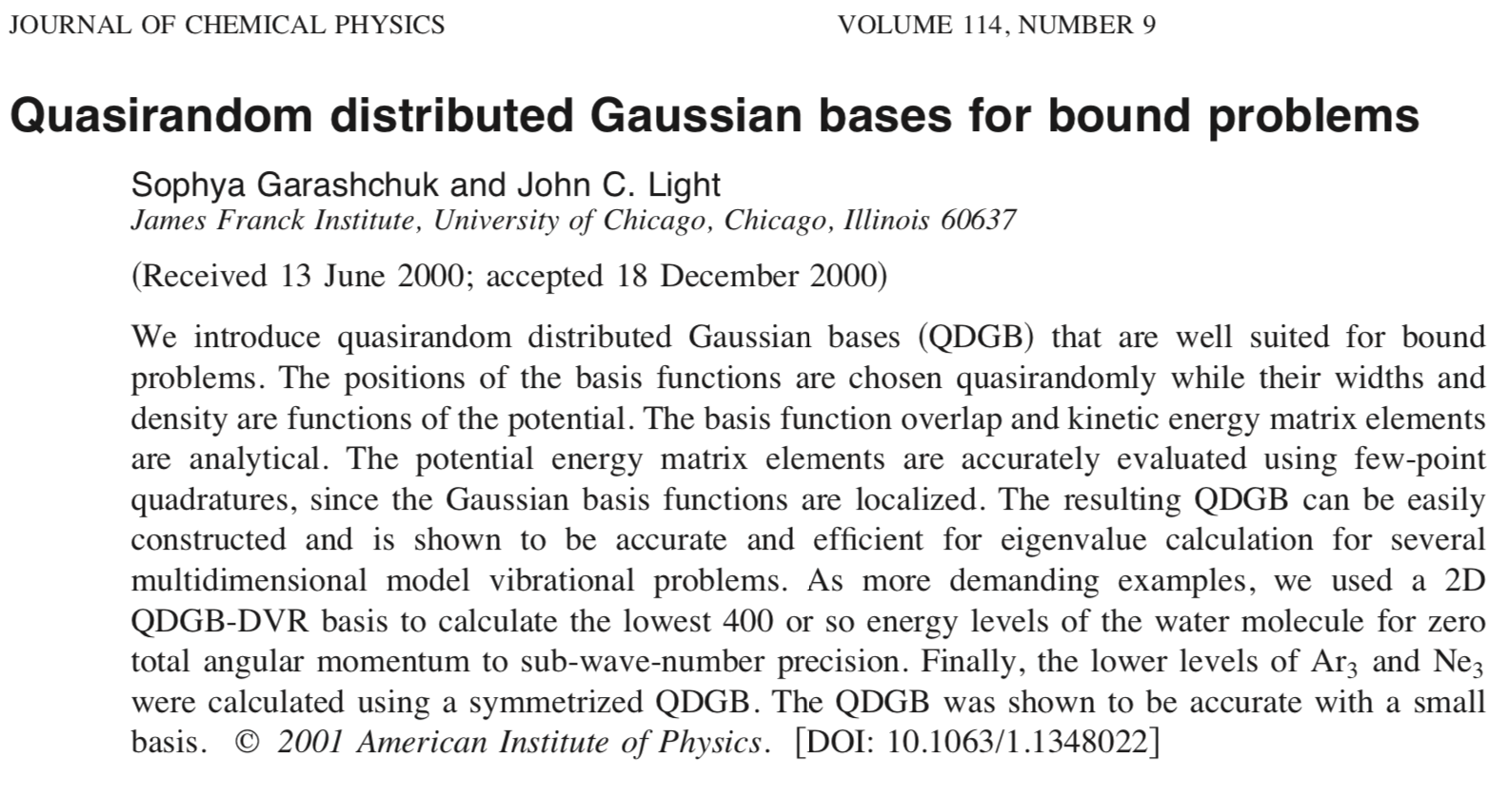

Slide 13
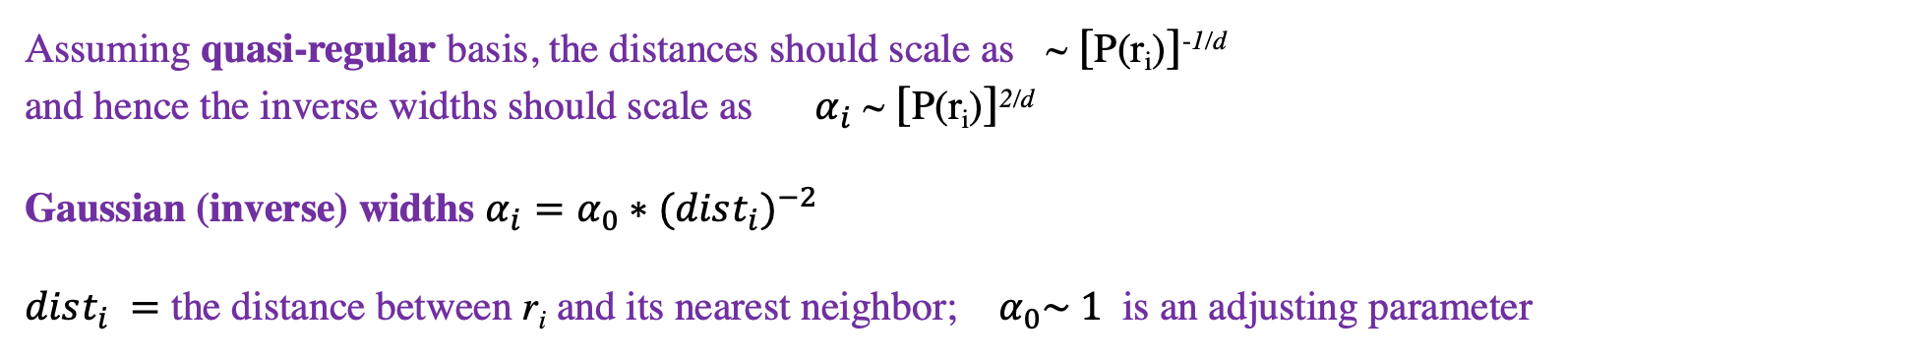
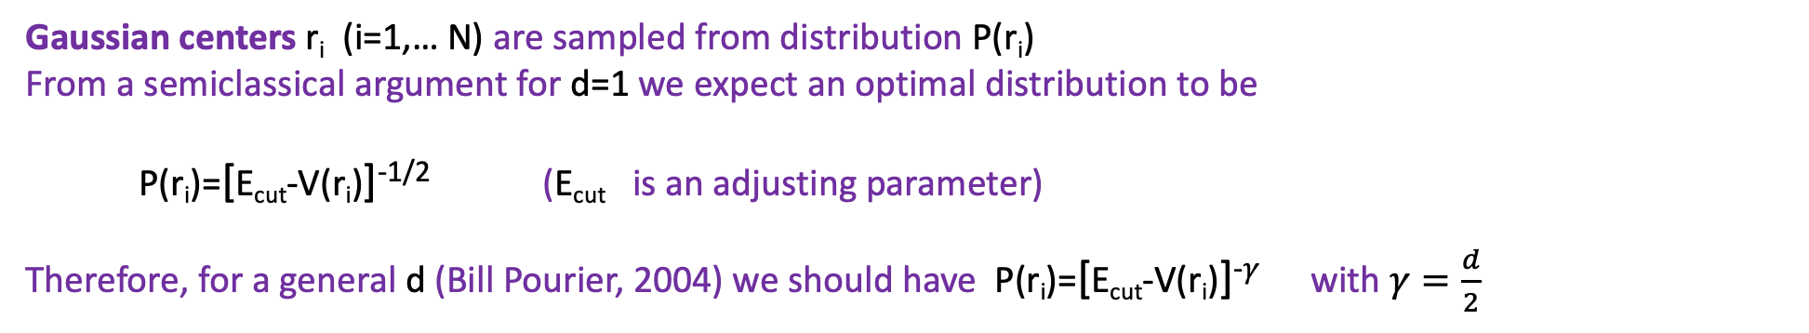
Given a potential energy V(r), how to distribute Gaussians?
(i=1, …, N)
Gaussian centers r_{i} (i=1,… N) are sampled from distribution P(r_{i})
From a semiclassical argument for d=1 we expect an optimal distribution to be
P(r_{i})=[E_{cut}-V(r_{i})]^{-1/2} (E_{cut} is an adjusting parameter)
Therefore, for a general d (Bill Pourier, 2004) we should have P(r_{i})=[E_{cut}-V(r_{i})]⁻$γ$ with $γ=\frac{d}{2}$
Garaschuk & Light (JCP 2001): use quasi-random + rejection method
Assuming quasi-regular basis, the distances should scale as ~ [P(r_{i})]^{-1/d}
and hence the inverse widths should scale as $α_{i}$ ~ [P(r_{i})]^{2/d}
Gaussian (inverse) widths $α_{i}=α_{0}∗{(dist_{i})}^{−2}$
$dist_{i} =$ the distance between r_{i} and its nearest neighbor; $α_{0}\sim 1$ is an adjusting parameter

Slide 14
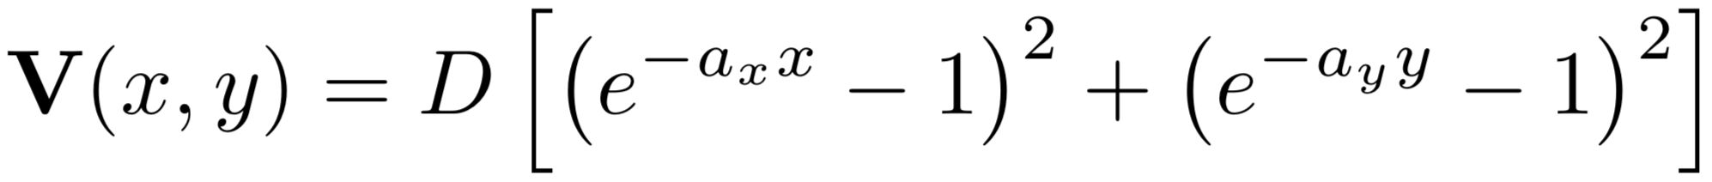
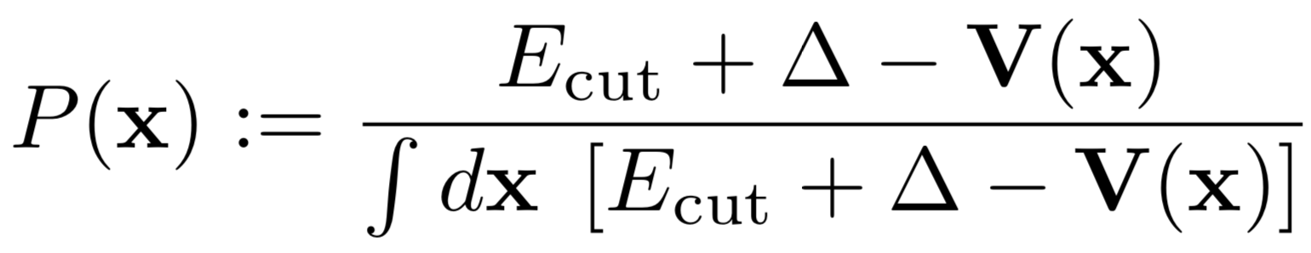
Sampling the 2D Morse potential
Following Garashchuk & Light JCP 2001
Flynn & VM (JCP 2019)

Slide 15
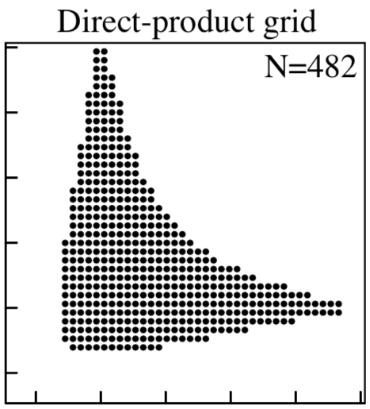
2D Morse potential.
Garashchuk & Light JCP 2001

Slide 16
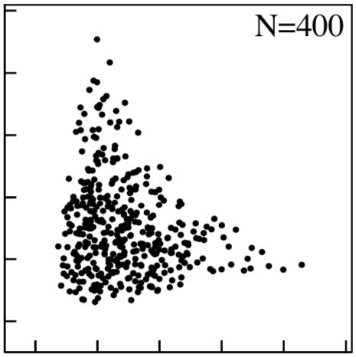
2D Morse potential.
Unif. Quasi-random+rejection
Garashchuk & Light JCP 2001

Slide 17
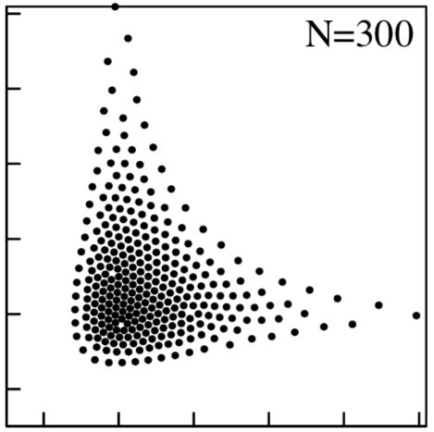
2D Morse potential.
Unif. quasi-random+rejection
Quasi-regular
Flynn & VM (JCP2019)

Slide 18
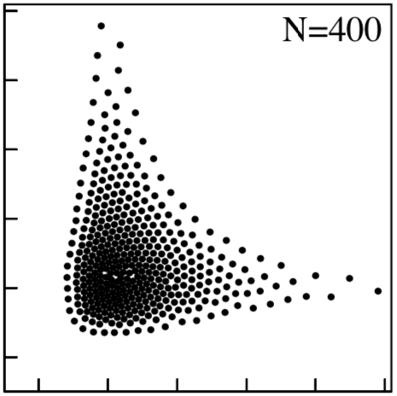
2D Morse potential.
Unif. quasi-random+rejection
Quasi-regular
Quasi-regular
Flynn & VM (JCP 2019)

Slide 19
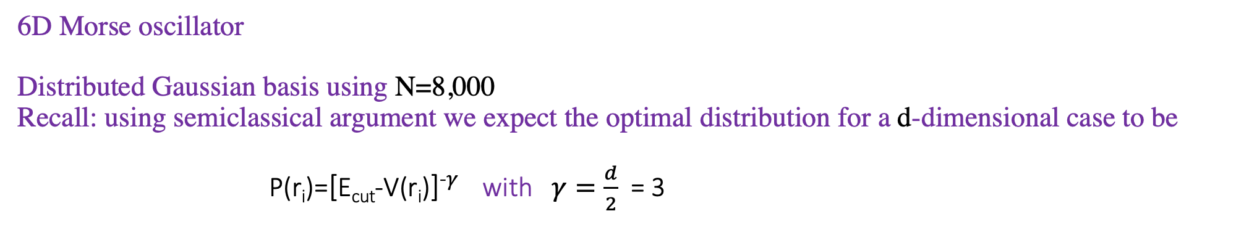
6D Morse oscillator Distributed Gaussian basis using N=8,000 Recall: using semiclassical argument we expect the optimal distribution for a d-dimensional case to be P(r_{i})=[E_{cut}-V(r_{i})]⁻$γ$ with $γ=\frac{d}{2}$ = 3
Relative error
Eigenvalue index

Slide 20
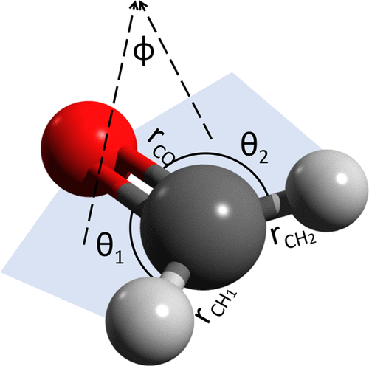
Calculating vibrational energies of a K-atom molecule using a rotationally and translationally invariant (Gaussian?) basis: we cannot use Cartesian coordinates

Slide 21
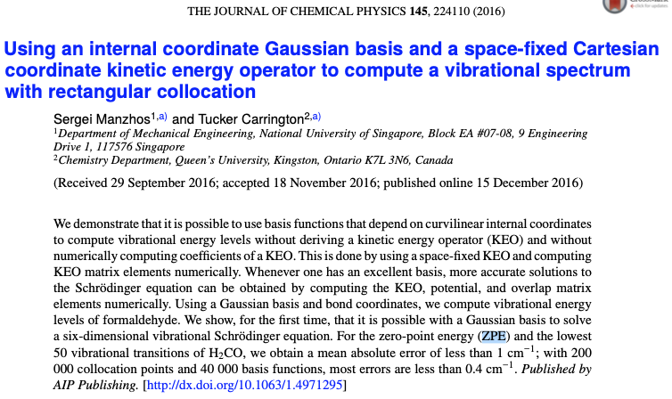

Slide 22
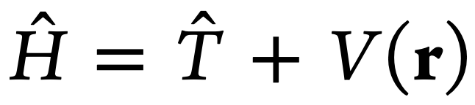
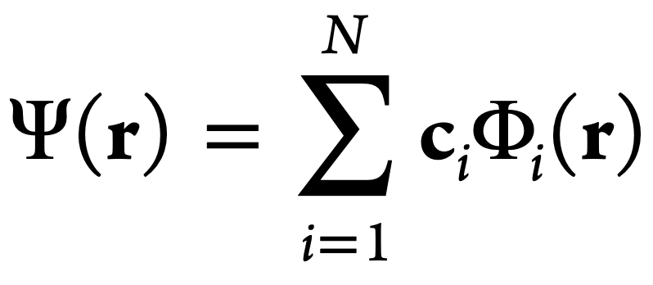
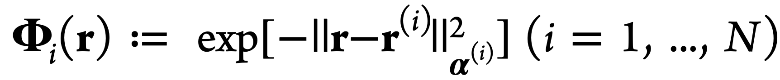
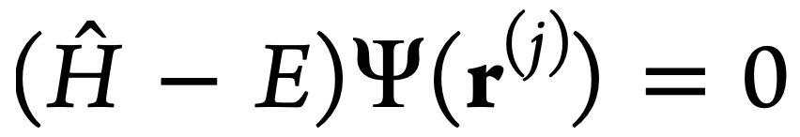
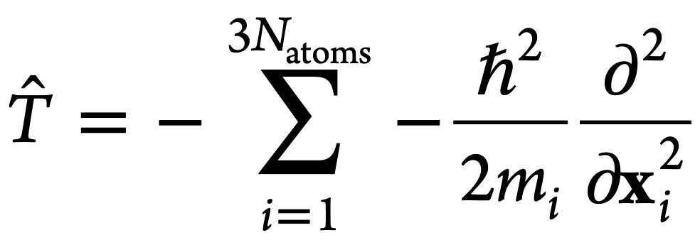
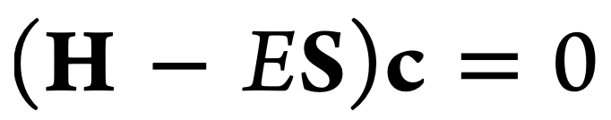
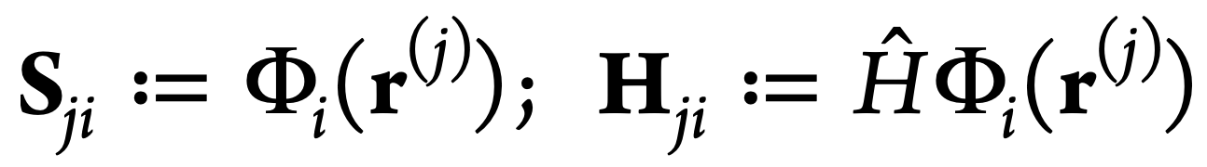
Molecular spectra calculations using internal coordinates, distributed Gaussian basis, and the collocation method
Molecular Hamiltonian (r are internal coordinates):
Expand the wavefunction in a Gaussian basis using internal coordinates:
The Schrödinger equation at the collocation points r^{(j)}:
Kinetic energy can be expressed in Cartesian
Coordinates and evaluated numerically by finite difference
We need to solve the generalized
eigenvalue problem

Slide 23
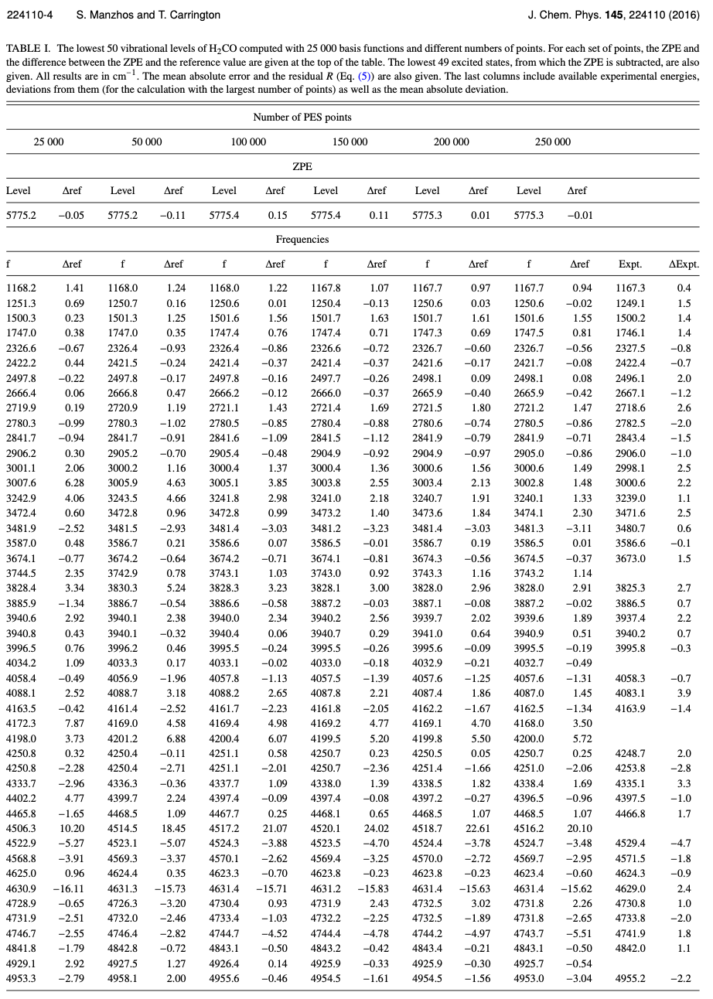
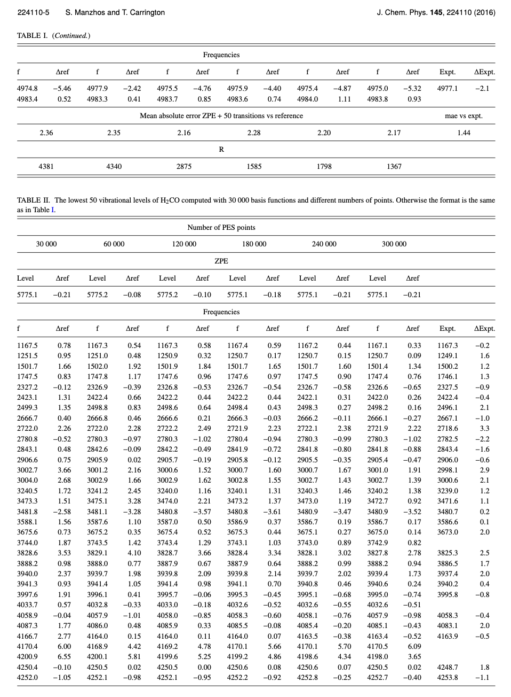
Manzhos & Carrington (JCP 2016): Using quasi-random+rejection Gaussian bases with N = 25 000, 39 000, 40 000

Slide 24
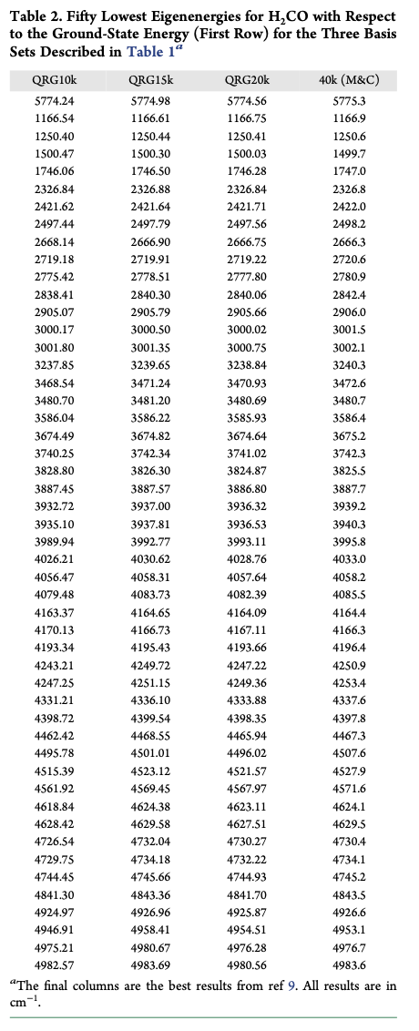
Flynn & Mandelshtam (JCTC 2021): using quasi-regular Gaussian basis with N = 10 000 for the lowest 50 eigenenergies
(The improvement is about factor of 3 compared to the results of Manzhos & Carrington)

Slide 25


Thank you
Shane Flynn
Sandra Brown

